Slide 1





LIVE TWITTER SENTIMENTAL ANALYSIS
CS255 | Software Group Project - II
Prepared By
18DCS007 | RUDRA BARAD
18DCS024 | HET GALIA
18DCS030 | MANAN JOSHI
4CSE1
DOMAIN
Data Mining
Data Analytics
Web Scrapping

Slide 2
Problem statement
In this advanced era of 21st Century the advancement in technology and Social Media has provided a platform to the people for posting their reviews , feedbacks & opinions about anything and everything.
These is were Sentiment analysis comes into picture. It is extremely useful in social media monitoring as it allows us to gain an overview of the wider public opinion behind certain topics.

Slide 3
Introduction to The Domain
DATA MINING
Data mining is the process of finding anomalies, patterns and correlations within large data sets to predict outcomes.
MACHINE LEARNING
Machine learning is the science of getting computers to act without being explicitly programmed.
WEB SCRAPING
It a technique used for extracting data from website or any other platform.

Slide 4
INTRODUCTION OF PROJECT
Our project is based on sentimental analysis of Twitter, in which we are fetching live tweets by using Twitter API and classifying it as positive, negative or neutral using machine learning.
We have provided the data set consisting of clusters of words and applied Naive Bayes Algorithm to train the model .

Slide 5
TECHNICAL ASPECT
Approach
DATA MINING
DATA ANALYTICS
Pre defined data processing modules are available for sentiment analysis
Accuracy is directly dependent on no. of tweets fetched for processing
Tweepy & TextBlob are used for processing and classification of tweet sentiment
PA data model needs to be trained for ML part in which the model is trained by applying natural language processing techniques & sentiment classification algos such as Naïve Bayes algo on datasets
The efficiency of trained data model depends upon the degree of feature extraction, most effective data, and the dataset based on which the data model is trained.
Live twitter sentiment analysis project has been developed using basic python programming and data processing modules.
*In both the approaches data set plays an important role in deciding accuracy of model.

Slide 6
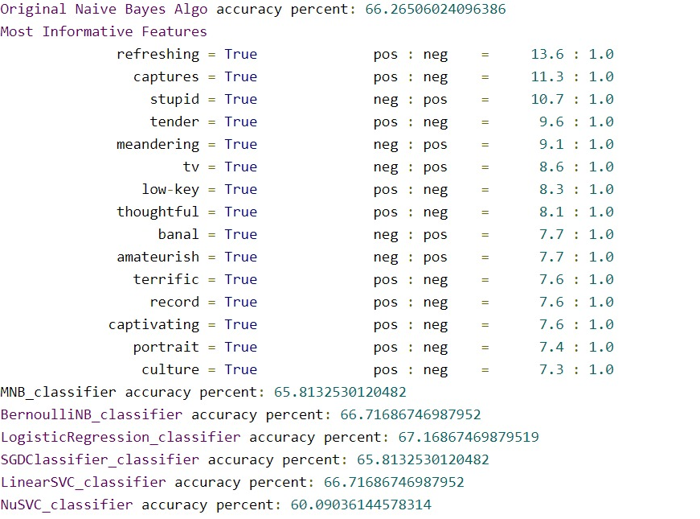
PREVIOUSLY TESTED ALGORITHMS

Slide 7
CURRENT SYSTEM & LIMITATIONS
Most of the current systems for live twitter sentiment analysis which use data mining are not able to fetch more than some particular amount of tweets. Some professionally developed system provide better accuracy and user interface but are extremely expensive to maintain. They also high maintenance. The professionally built systems requires high configuration softwares and also requires a user to have some basic understanding of the system to use it.

Slide 8
WHAT’S NEW
Our system does not require any high configuration devices or softwares to execute or for processing.
In our system we have tried to reduce the data model training time to get instant and efficient results for the machine learning part.
In this system the live tweet feed is fetched directly from twitter using twitter API which overcomes the limited tweets fetching problem.
The project can be easily implemented by even the users with no knowledge regarding the project ,so it is extremely user friendly.

Slide 9



HARDWARE AND SOFTWARE USED
01 | Hardware
Laptop/computer with Core i5 8TH gen. Processor.
Good Internet Connectivity.
02 | Software
Python Environment
Python Compiler
Natural Language Tool
CMD
TWEEPY – A pre-defined module for fetching live tweets

Slide 10
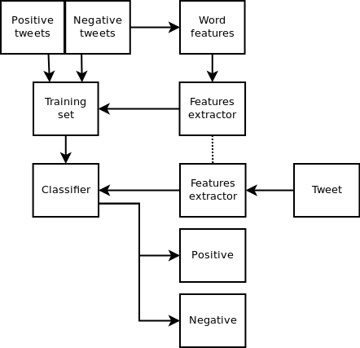
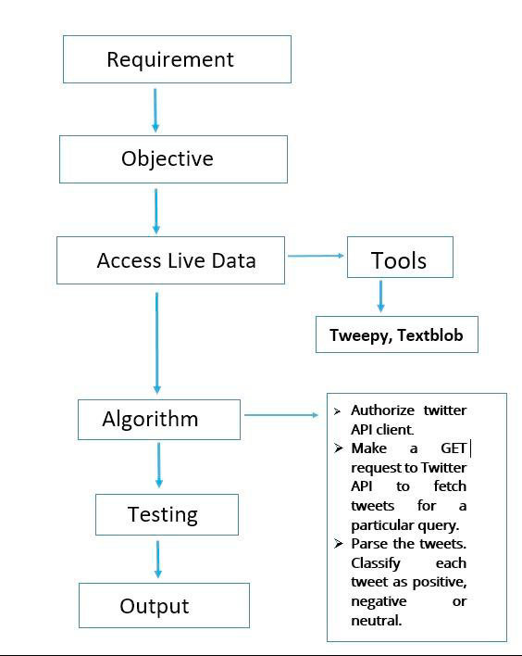
FLOWCHART

Slide 11
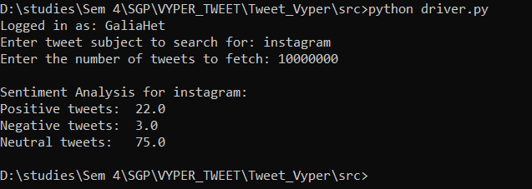
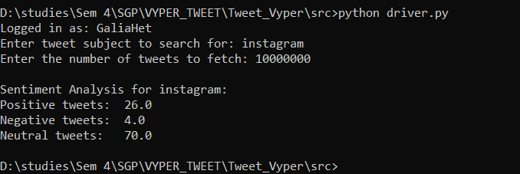
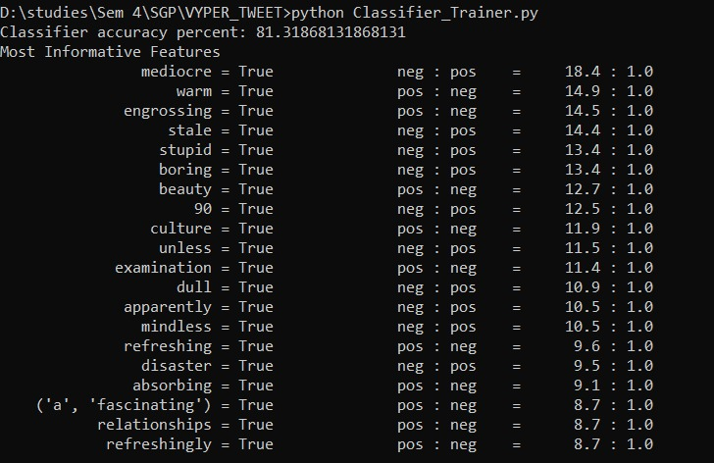
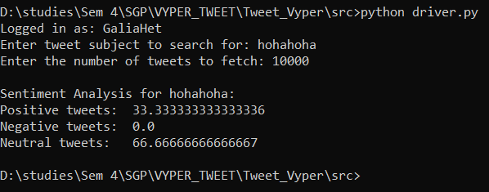
SNAPSHOTS OF THE PROJECT

Slide 12
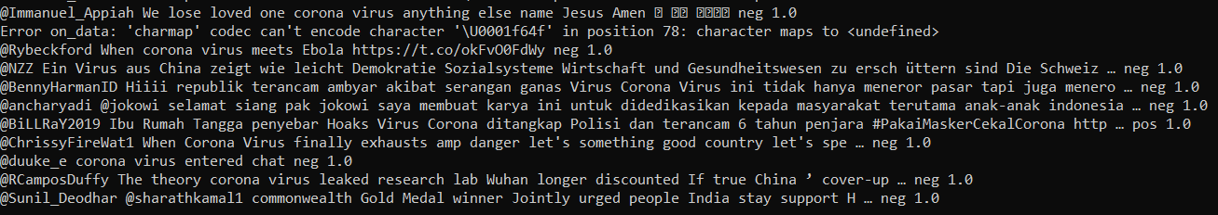
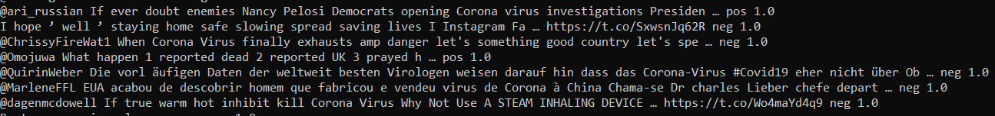
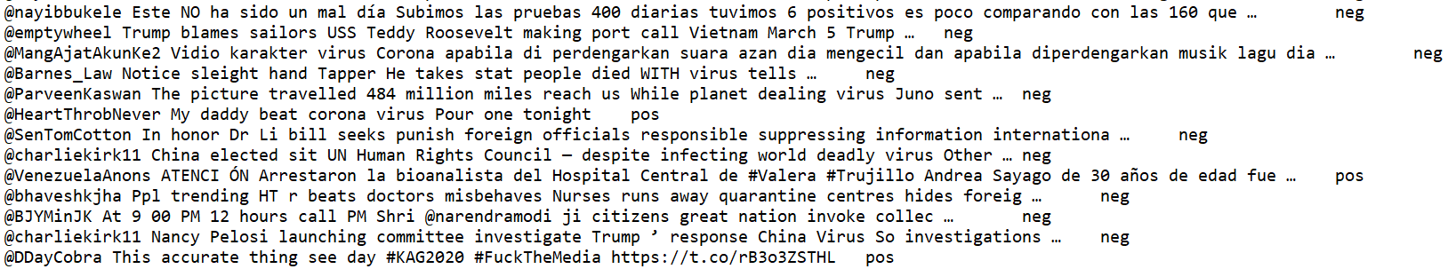
SNAPSHOTS OF THE PROJECT

Slide 13
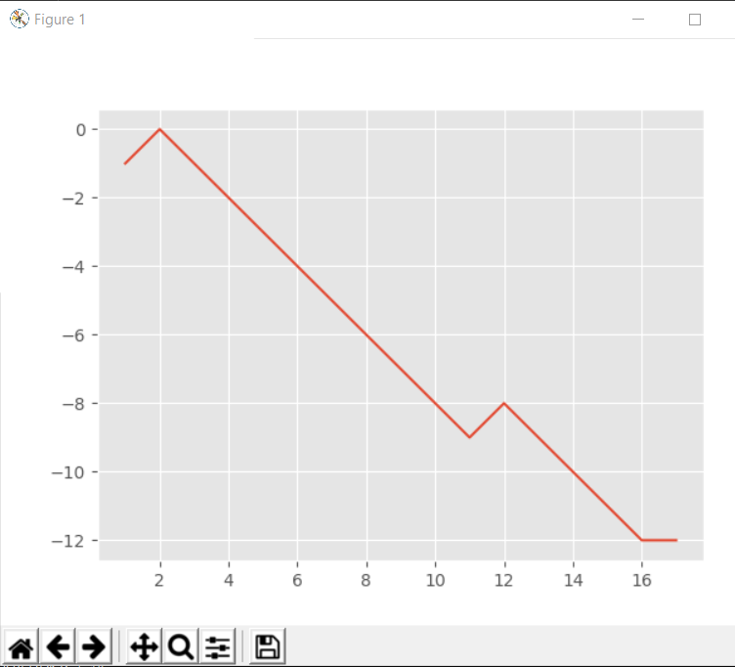
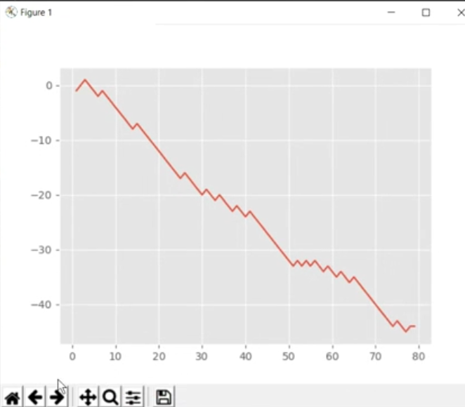
SNAPSHOTS OF THE PROJECT
81.3%
Accuracy

Slide 14
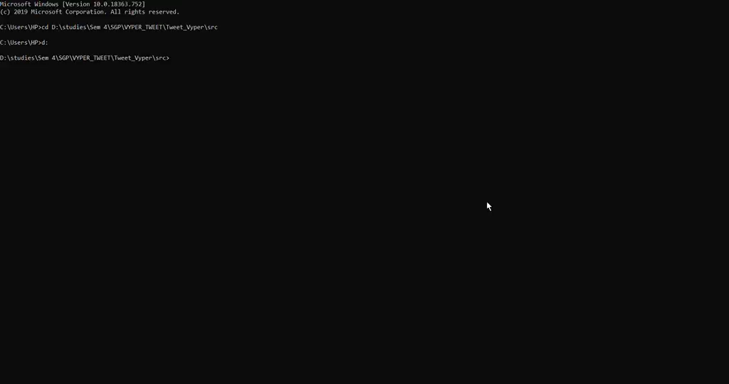
VIDEO DEMONSTRATION OF THE PROJECT

Slide 15
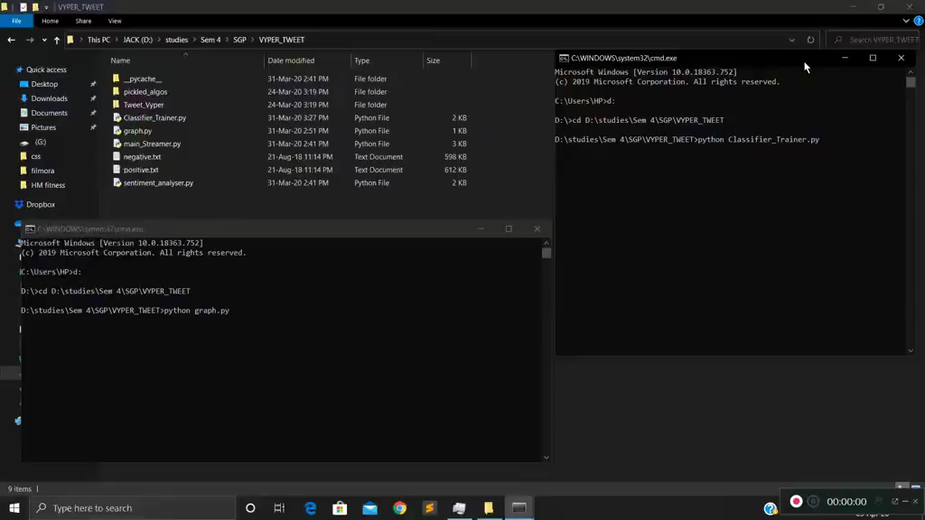
VIDEO DEMONSTRATION OF THE PROJECT

Slide 16
LIMITATIONS & FUTURE SCOPE
In this project we have used cluster of words in the File to train the model so as to predict whether the tweet is positive or negative.
Accuracy is directly proportional to available data set. There is always a scope to increase the Accuracy.

Slide 17
CONCLUSION
In our Project we are fetching live tweets from twitter.
After fetching the tweets from twitter, we have used to approaches for classifying the tweets:
Using Data Mining we classified the tweets as positive, Negative or neutral.
We have trained a model using machine learning that would predict whether the tweet is positive or negative .Along with this it would represent the data using graph. We have used Simple Command prompt and Python Environment (NLTK).
This analysis would help in monitoring the responses of the public.

Slide 18
References
https://towardsdatascience.com/live-sentiment-analysis-on-twitter-data-using-tweepy-keras-and-django-99c344e90488
https://pythonprogramming.net/graph-live-twitter-sentiment-nltk-tutorial/
https://monkeylearn.com/blog/sentiment-analysis-of-twitter/
https://www.csc2.ncsu.edu/faculty/healey/tweet_viz/tweet_app/
https://towardsdatascience.com/creating-the-twitter-sentiment-analysis-program-in-python-with-naive-bayes-classification-672e5589a7ed

Slide 19
THANKYOU

